Slide 1

Project Apollo
A demand forecast modeling for Diabetes and Obesity Drugs in UK
-- The god of medicine and prophecies to the rescue…
By Rajas Khokle, PhD

Slide 2
Contents
The Dataset
ETL Process
EDA Process
ARIMA Model
FBPROPHET Model

Slide 3
The Dataset
- Let the dataset change your mindset.

Slide 4
The Dataset
Consists of GP prescription data from UK from Oct 2010 to Dec. 2018. That’s 1 billion rows of data.
Contains record of drug prescription that has
Drug Name
Drug’s BNF Code
Quantity and Total Cost
Address of the GP who issued the drugs.
Out of 35 k different drugs and appliances, 6 are chosen for investigation and forecasting.

Slide 5
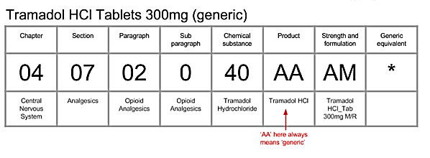
BNF Codes
01 – Gastric Problems
02 – Cardiovascular System 03 – Respiratory System
04 – Central Nervous System
05 – Infections
06 – Endocrine System ……… and so on!

Slide 6




Jan 2011
July 2016
Dec 2018
Extract and group the drugs prescriptions based on BNF Codes .
Create index on BNFCODES for faster data access.
Join the transaction and address tables for Map Visualizations
Group Prescriptions by month and drug.

Slide 7
The Drugs for Diabetes
Metformin - A first line of treatment for diabetes
Insulin – Humulin – Human Insulin
Insulin – Lantus – Insulin Analog
Orlistat – A Weight loss pill

Slide 8
Lets Move To The Tableau Visualization
- Let the Tableau … Flow...

Slide 9
The Seasonal Decomposition

Slide 10
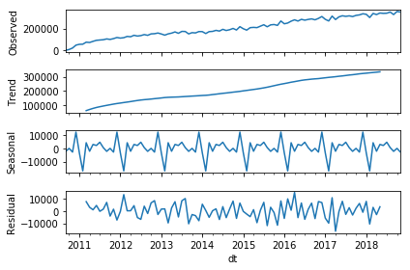
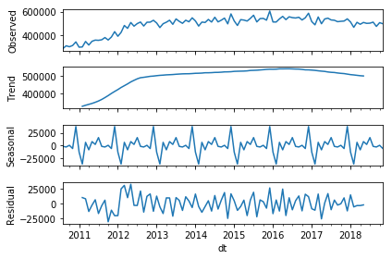
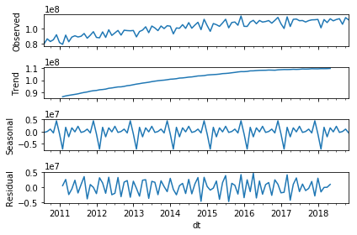

Humulin
Lantus
This is My December !
Metformin

Slide 11
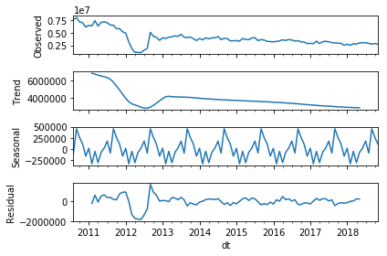
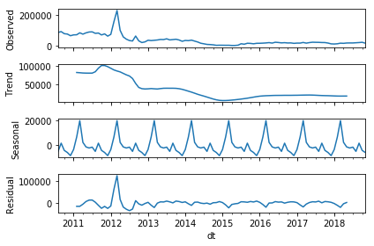
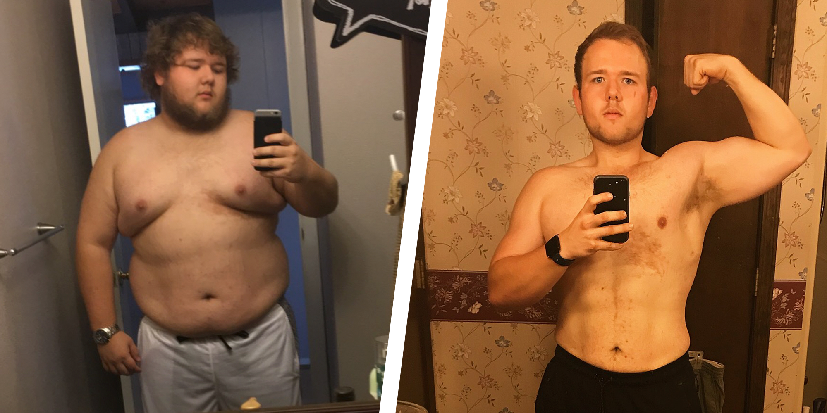
Orlistat 120 mg
Orlistat 60 mg
My Summer Resolution !

Slide 12
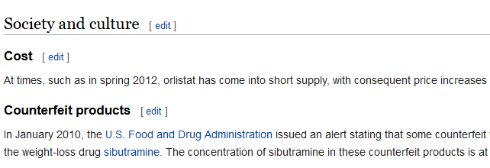

Slide 13
ARIMA

Slide 14
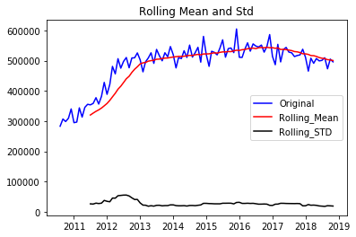
Glargine Pens

Slide 15
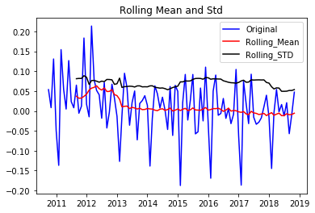
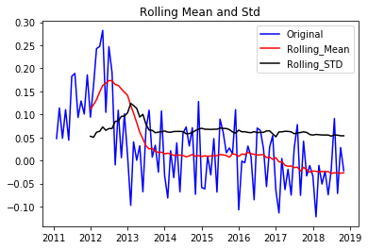
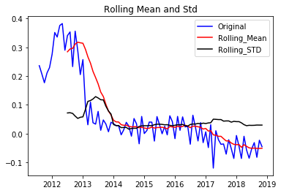
Lag = 2
Lag = 6
Lag = 12

Slide 16
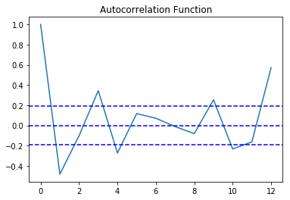
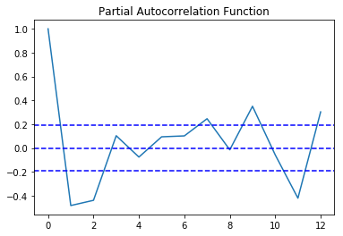
P = 4 or P =5
Q = 3 to 8

Slide 17
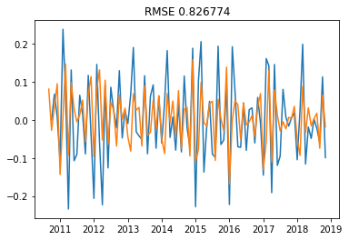
P = 5 , D = 1, Q = 4

Slide 18
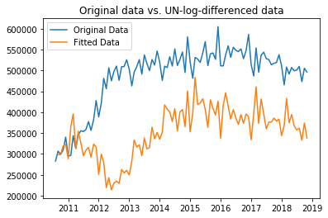
What Just Happened ?

Slide 19
FBPROPHET
- That One Good Thing by Facebook ...

Slide 20
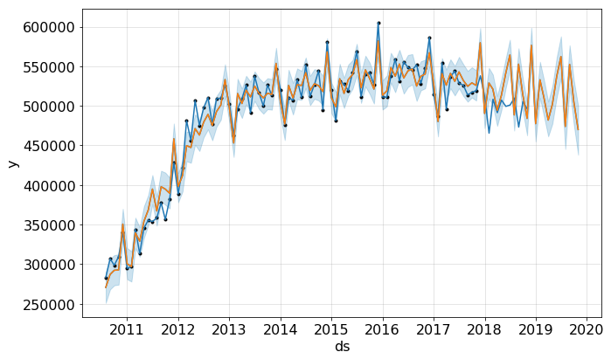
Glargine Pens

Slide 21
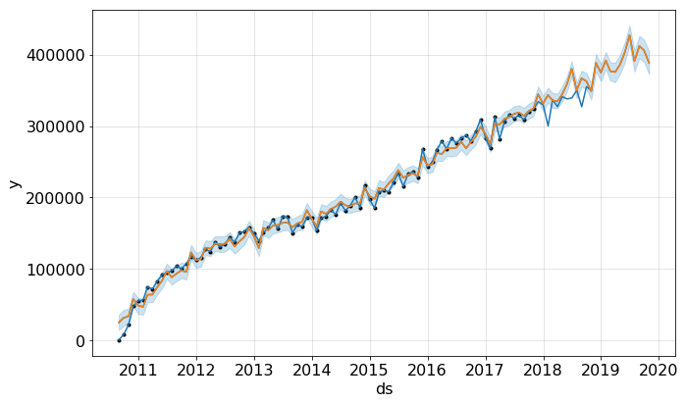
Humulin Pens

Slide 22
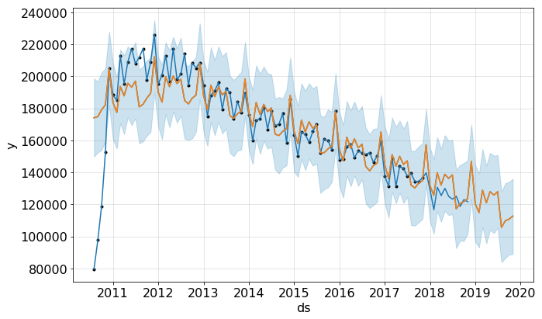
Humulin Refill Cartridges

Slide 23
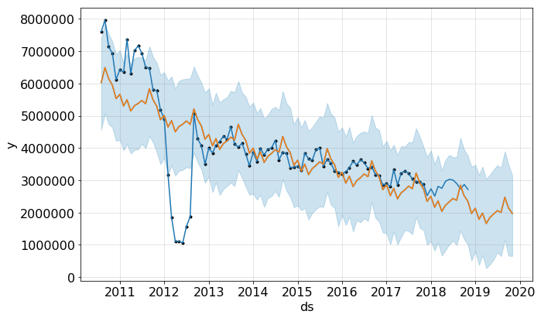
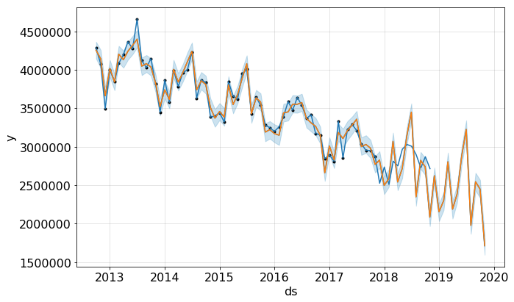
Orlistat 120
After
Orlistat 120
BEFORE

Slide 24
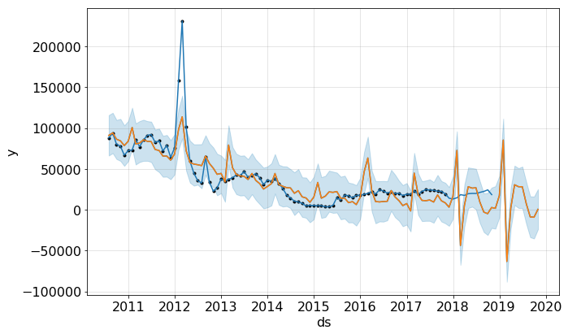
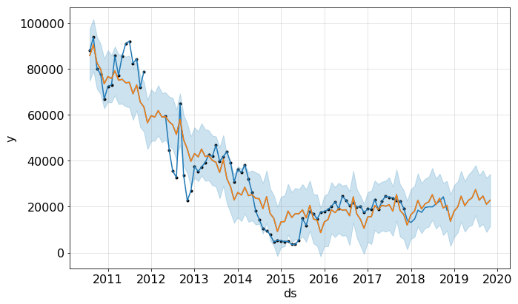
Orlistat 60
After
Orlistat 60
BEFORE

Slide 25
That’s All Folks ! Thank You!

